Slide 1




Advanced ParFlow Short Course CLM Activities
October 3-4, 2019
University of Arizona
Laura Condon, University of Arizona
Nick Engdahl, Washington State University
Reed Maxwell, Colorado school of Mines
This material and short course was supported by the National Science Foundation and Department of Energy

Slide 2
Common Land Model Activity 1: Finding Variables
Developed by:
Jennifer Jefferson

Slide 3
Why should you know how to find variables in the CLM code?
Inevitably, someone will ask: “How does the model compute x?”
You want to change how the model computes x
You want to know where a variable from the input file is used

Slide 4
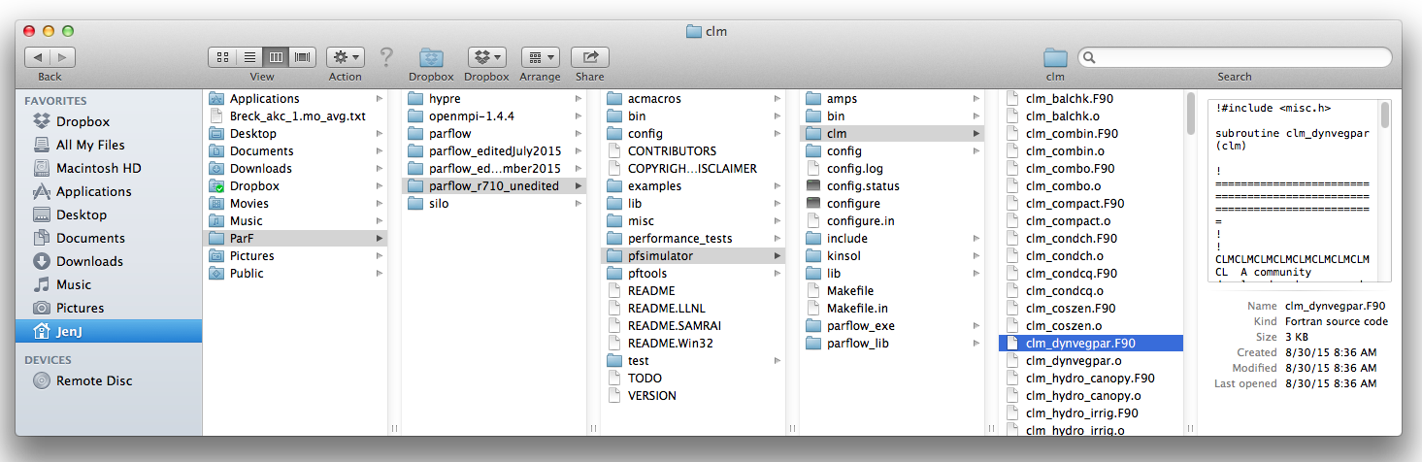
Where do you search for variables?
pfsimulator – clm folder includes all CLM .F90 modules parflow_lib folder includes solver_richards.c

Slide 5
How do you search for a variable?
(on a Mac)
Type in name to search bar in Finder window
Use grep (global regular expression print) command from terminal window

Slide 6
Variations of grep
http://www.gnu.org/software/grep/manual/grep.htm
-l list names of files
-r recursively look through files in a given directory
* wildcard symbol
grep command is very similar on Linux http://www.tecmint.com/12-practical-examples-of-linux-grep-command/
http://www.computerhope.com/unix/ugrep.htm

Slide 7
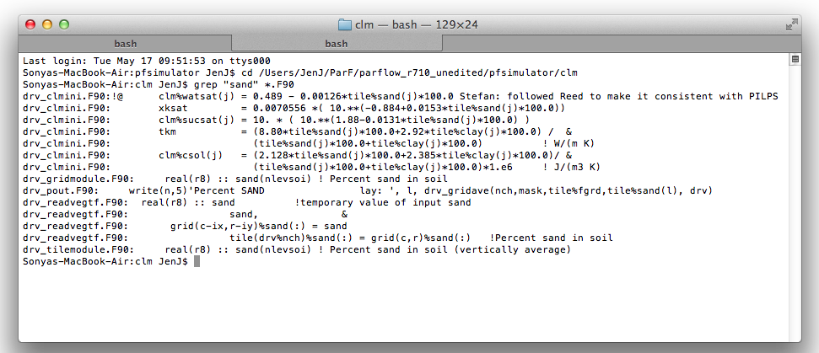
Let’s do an example: sand (from drv_vegm.dat)
1. Navigate to director to search in
2. Search for “sand” in Fortan files within the directory

Slide 8
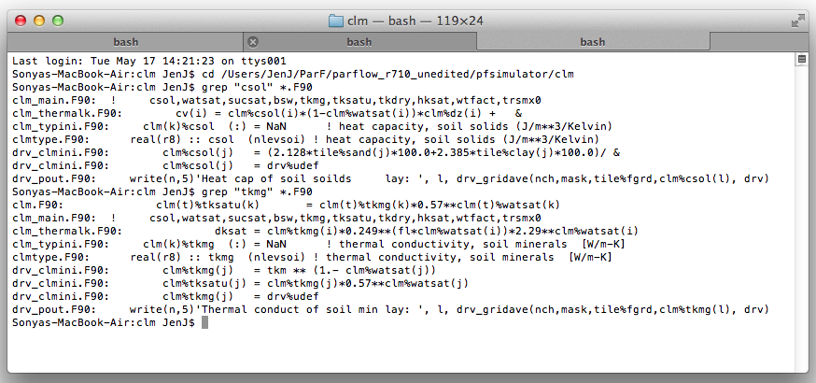
Example (sand)

Slide 9
Example (sand)
Variable Name | sand
Description | percent sand in soil
Units | decimal (-)
Global or Local variable | global
Constant or varying? | Constant for each tile, can vary between tiles
CLM Modules | drv_clmini.F90 drv_gridmodule.F90 drv_pout.F90 drv_readvegtf.F90 drv_tilemodule.F90
If/Do statements? | For every soil layer (nlevsoi)
Additional comments | Sand used to compute variables clm%tkmg, clm%csol -> clm_thermalk.F90 -> heat capacity for ground heat flux

Slide 10
You do: Pick variable(s) you might be interested in, use grep command to find out more information
Vegetation | Ground | Atmosphere
efpot | eflx_evap_soi | forc_hgt_t
eflx_evap_tot | surfalb | hsub
fdry | zsno | displa
qflx_through | csoilc | co2, pco2
seasb | t_soisno | forc_pbot

Slide 11
You do: Find information about variable(s)
Variable Name
Description
Units
Global or Local variable
Constant or varying?
CLM Modules
If/Do statements?
Additional comments

Slide 12
You do: Find information about variable(s)
Variable Name
Description
Units
Global or Local variable
Constant or varying?
CLM Modules
If/Do statements?
Additional comments

Slide 13
Tips
Make sure lines are not commented out (!)
Code updates are typically annotated with developers initials, for example:
RMM = Reed Maxwell
IMF = Ian Ferguson
NBE = Nick Engdahl
Be careful of rabbit holes - some variables are more difficult to track down and follow than others
Find where variable is initialized
Look at flowchart to see order modules are called

Slide 14
Common Land Model Activity 2: Testing Single Columns
Developed by:
Jennifer Jefferson
Note: Demo is for operation of PF-CLM from a local version installed on a Mac.

Slide 15
Why would you want to test CLM with single columns?
Computationally cheaper than whole domain simulation
Can quickly run simulation on laptop
Isolate variable
Obtain information about variable not output (by default) from CLM
Isolate period of time or scenario
Compare effect of change
Clarify computation or conceptual understanding

Slide 16
Activity 2
(demo portion)
Goal: Output and plot 2 variables from CLM
Variables of interest:
clm%btran – vegetation water stress (for transpiration)
taf – canopy air temperature
Both variables are located in clm_leaftem.F90
Neither variable is written out of the model

Slide 17
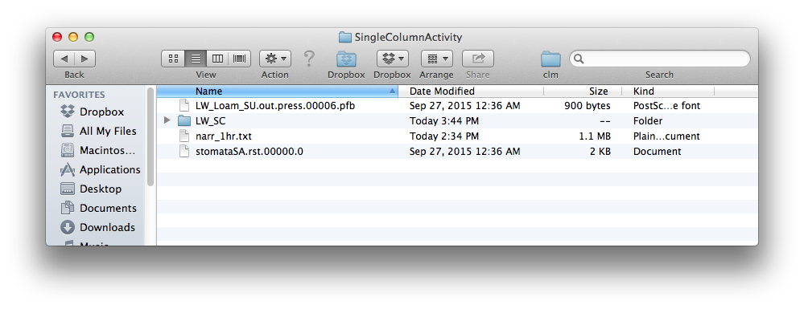
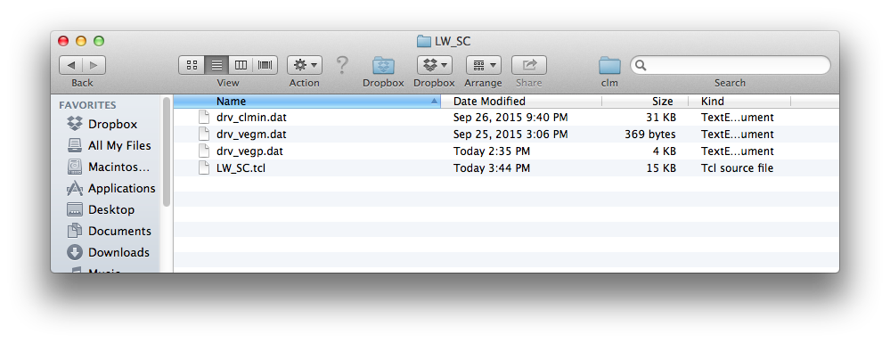
Step 1: Obtain (or locate) files in a folder called “SingleColumnActivity”
Put folder somewhere on your computer, but leave files in this arrangement.

Slide 18
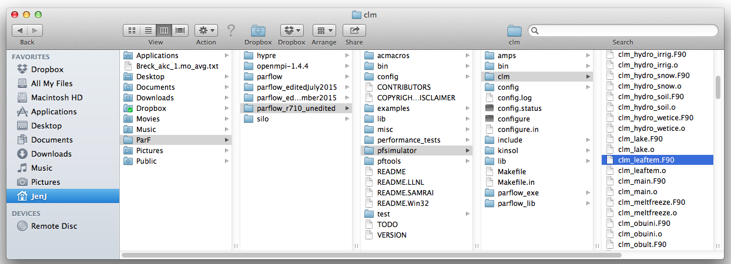
Step 2: Add print statement to clm_leaftem.F90
Navigate to clm_leaftem.F90
Open the file and at the bottom of clm_leaftem.F90 add (will print to …out.txt):
! Update dew accumulation (kg/m2)
clm%h2ocan = max(dble(0.),clm%h2ocan + (clm%qflx_tran_veg-clm%qflx_evap_veg)*clm%dtime)
print*,'111', clm%btran, taf
end subroutine clm_leaftem

Slide 19
Tips
Be thoughtful about placement of print statement
Not in a loop
Before final value is computed
Select variables strategically so that you can make offline calculations
To duplicate output
Think ahead, if possible

Slide 20
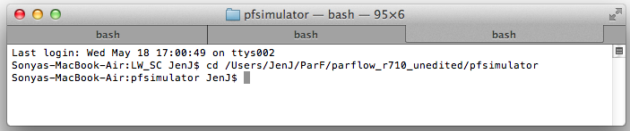
Step 3: Recompile PF-CLM
Open the terminal window
Navigate to pfsimulator folder
cd ...
Recompile code by typing
make install

Slide 21
Step 4: Run tcl script
Open a new tab in the terminal window (command+t)
Navigate to the “SingleColumnActivity – LW_SC” folder
cd ...
Run tcl script
tclsh LW_SC.tcl

Slide 22
Step 5: Post-process data
(I used R to load, compare and plot data)
(more moisture, does not limit photosynthesis as much)
(less moisture, limits photosynthesis more)

Slide 23
Step 5: Post-process data
(air > canopy)
(air < canopy)

Slide 24
Step 5: Post-process data
Sept.
Oct.
Nov.

Slide 25
Activity 2
(active portion)
Goal: Run a single column domain and plot variable from single file output
Example single column setup is provided:
.tcl script
(3) CLM files
1D forcing file
Little Washita, OK
File begins on September 1, 1998 at 0 GMT
(7pm CT August 31, 1998)
Pressure file
Restart file

Slide 26
(Some) Decisions to Make
How many time steps to simulate?
Restart or not?
What CLM variable to plot?
See end of introduction slides for list and order
set stopt 2184.0
pfset TimingInfo.BaseUnit 1.0
pfset TimingInfo.StartCount 0
pfset TimingInfo.StartTime 0.0
pfset TimingInfo.StopTime $stopt
pfset TimingInfo.DumpInterval 1.0
pfset TimeStep.Type Constant
pfset TimeStep.Value 1.0
#pfset ICPressure.Type HydroStaticPatch
#pfset ICPressure.GeomNames domain
#pfset Geom.domain.ICPressure.Value -1.0
#pfset Geom.domain.ICPressure.RefGeom domain
#pfset Geom.domain.ICPressure.RefPatch z-upper
pfset ICPressure.Type PFBFile
pfset ICPressure.GeomNames domain
pfset Geom.domain.ICPressure.FileName "LW_Loam_SU.out.press.00006.pfb"
pfdist "LW_Loam_SU.out.press.00006.pfb"

